Slide 1
Buffer Overflows
Emiliano De Cristofaro

Slide 2
Software
sequence of instructions in memory
logically divided in functions that call each other
function ‘IE’ calls function ‘getURL’ to read the corresponding page
in CPU, the program counter contains the address in memory of the next instruction to execute
normally this is the next address (instruction 100 is followed by instruction 101, etc)
not so with function call
204
return result
203
202
getURL
201
200
104
103
IE
102
call getURL
101
100

Slide 3
Software
sequence of instructions in memory
logically divided in functions that call each other
function ‘IE’ calls function ‘getURL’ to read the corresponding page
in CPU, the program counter contains the address in memory of the next instruction to execute
normally this is the next address (instruction 100 is followed by instruction 101, etc)
not so with function call
PC
204
return result
PC
203
PC
202
getURL
PC
201
PC
200
PC
104
PC
103
PC
IE
102
call getURL
PC
101
PC
100

Slide 4
Software
1024
103
stack pointer (SP)
Points to last added entry
on the stack
1023
stack
1022
1021
1020
PC
so how does our CPU know where to return?
it keeps administration
on a ‘stack’
204
return result
PC
203
PC
202
PC
getURL
201
PC
200
104
PC
103
PC
IE
102
call getURL
PC
101
PC
100

Slide 5
Real Functions
getURL ()
{
char buf[10]; read(keyboard,buf,64); get_webpage (buf);
}
IE ()
{ getURL ();
}

Slide 6
Real Functions
getURL ()
{
char buf[10]; read(keyboard,buf,64); get_webpage (buf);
}
IE ()
{ getURL ();
}
203
return result
202
getURL
201
call read
200
104
103
102
call getURL
IE
101
100

Slide 7
Real Functions
stack
1024
103
1023
old FP
frame pointer (FP)
Points to start of this function’s stack frame
1022
getURL ()
{
char buf[10]; read(keyboard,buf,64); get_webpage (buf);
}
IE ()
{ getURL ();
}
1021
1020
1019
1018
203
return result
1017
202
getURL
1016
201
call read
1015
200
1014
1013
1012
104
1011
103
1010
102
call getURL
IE
101
100

Slide 8
Real Functions
stack
1024
103
303
return
1023
old FP
302
read
1022
301
getURL ()
{
char buf[10]; read(keyboard,buf,64); get_webpage (buf);
}
IE ()
{ getURL ();
}
1021
300
1020
1019
1018
buf
203
return result
1017
202
getURL
1016
201
call read
1015
200
1014
1013
1012
104
1011
103
1010
102
call getURL
1009
IE
101
1008
100
1007

Slide 9
Real Functions
stack
1024
103
303
return
stack
1023
old FP
302
read
1022
301
getURL ()
{
char buf[10]; read(keyboard,buf,64); get_webpage (buf);
}
IE ()
{ getURL ();
}
1021
300
1020
1019
1018
buf
203
return result
1017
202
getURL
1016
201
call read
1015
200
1014
1013
1012
64
104
1011
(buf)
103
1010
fd
102
call getURL
1009
IE
101
1008
100

Slide 10
Real Functions
stack
1024
103
303
return
1023
old FP
302
read
1022
301
getURL ()
{
char buf[10]; read(keyboard,buf,64); get_webpage (buf);
}
IE ()
{ getURL ();
}
1021
300
1020
1019
1018
buf
203
return result
1017
202
getURL
1016
201
call read
1015
200
1014
1013
1012
64
104
1011
(buf)
103
1010
fd
102
call getURL
1009
202
IE
101
1008
100

Slide 11
Real Functions
stack
1024
103
303
return
1023
old FP
302
read
1022
301
getURL ()
{
char buf[10]; read(keyboard,buf,64); get_webpage (buf);
}
IE ()
{ getURL ();
}
1021
300
1020
1019
1018
203
return result
1017
202
getURL
1016
201
call read
1015
200
1014
1013
1012
64
104
1011
(buf)
103
1010
fd
102
call getURL
1009
202
IE
101
1008
1023
100
frame pointer (FP)

Slide 12
Real Functions
stack
1024
103
303
return
1023
old FP
302
read
1022
301
getURL ()
{
char buf[10]; read(keyboard,buf,64); get_webpage (buf);
}
IE ()
{ getURL ();
}
1021
300
1020
1019
1018
203
return result
1017
202
getURL
1016
201
call read
1015
200
1014
1013
1012
64
104
on “return
from read”
1011
(buf)
103
1010
fd
102
call getURL
1009
202
IE
101
1008
1023
100

Slide 13
Real Functions
stack
1024
103
303
return
1023
old FP
302
read
1022
301
getURL ()
{
char buf[10]; read(keyboard,buf,64); get_webpage (buf);
}
IE ()
{ getURL ();
}
1021
300
1020
1019
1018
203
return result
1017
202
getURL
1016
201
call read
1015
200
1014
1013
1012
64
104
1011
(buf)
103
1010
fd
102
call getURL
POP
1009
202
IE
101
1008
1023
100

Slide 14
Real Functions
stack
1024
103
303
return
1023
old FP
302
read
1022
301
getURL ()
{
char buf[10]; read(keyboard,buf,64); get_webpage (buf);
}
IE ()
{ getURL ();
}
1021
300
1020
1019
1018
203
return result
1017
202
getURL
1016
201
call read
1015
200
1014
1013
1012
64
104
1011
(buf)
103
1010
fd
102
call getURL
1009
202
IE
101
1008
1023
100

Slide 15
Real Functions
stack
1024
103
303
return
1023
old FP
302
read
1022
301
getURL ()
{
char buf[10]; read(keyboard,buf,64); get_webpage (buf);
}
IE ()
{ getURL ();
}
1021
300
1020
1019
1018
203
return result
1017
202
getURL
1016
201
call read
1015
200
1014
1013
1012
64
104
1011
(buf)
103
1010
fd
102
call getURL
1009
202
IE
101
1023
RET
1008
100

Slide 16
Real Functions
stack
1024
103
303
return
1023
old FP
302
read
1022
301
getURL ()
{
char buf[10]; read(keyboard,buf,64); get_webpage (buf);
}
IE ()
{ getURL ();
}
1021
300
1020
1019
1018
203
return result
1017
202
getURL
1016
201
call read
1015
200
1014
1013
1012
64
104
1011
(buf)
103
1010
fd
102
call getURL
1009
202
IE
101
1008
1023
100

Slide 17
Where is the vulnerability?

Slide 18
Exploit
1013
1024
103
1023
1022
getURL ()
{
char buf[10]; read(keyboard, buf, 64); get_webpage (buf);
}
IE ()
{ getURL ();
}
1021
1020
1019
1018
buf
1017
1016
1015
1014
1013
1012
1011
1010

Slide 19
Caveats
If you make the program crash, exploitation fails
By exploiting the stack, you may overwrite other things
Other variables that are also on the stack
Other addresses
Etc.

Slide 20
Let’s make it real

Slide 21
Memory Layout of a Process
0xbfffffff
ENV/ARG strings
argc
Stack
Heap
bss
data
text
0x08048000
Notes:
bss is used by many compilers and linkers for the portion of an object file or executable containing statically-allocated variables that are not explicitly initialized to any value. It is often referred to as the "bss section" or "bss segment".

Slide 22
Real Code
Addresses are written in hexadecimal
Consider the assembly code for IE()
Push Frame Pointer on the stack
Beginning of function
Store Stack Pointer in Frame Pointer
0x08048428 <+0>: push %ebp
0x08048429 <+1>: mov %esp,%ebp
0x0804842b <+3>: call 0x8048404 <getURL>
0x08048430 <+8>: pop %ebp
0x08048431 <+9>: ret
Call getURL()
Return
Restore Frame Pointer
$$2^{0}∙1+2^{4}∙3+2^{8}∙4+2^{12}∙8+2^{16}∙4+2^{20}∙0+2^{24}∙8+2^{28}∙0$$
Two characters denote the value of a byte

Slide 23
Similarly
Same function preamble
The assembly code for getURL():
0x08048404 <+0>: push %ebp
0x08048405 <+1>: mov %esp,%ebp
0x08048407 <+3>: sub $0x18,%esp
0x0804840a <+6>: mov 0x804a014,%eax
0x0804840f <+11>: movl $0x40,0x8(%esp)
0x08048417 <+19>: lea -0xc(%ebp),%edx
0x0804841a <+22>: mov %edx,0x4(%esp)
0x0804841e <+26>: mov %eax,(%esp)
0x08048421 <+29>: call 0x8048320 <read@plt>
0x08048426 <+34>: leave
0x08048427 <+35>: ret
Make space for buffer and the 3 parameters to read()
Call to read()

Slide 24
Putting the pieces together
read
(code for read)
getURL ()
{
char buf[40]; read(stdin,buf,64); get_webpage (buf);
}
IE ()
{ getURL ();
}
0x08048431
ret
pop %ebp
call 0x8048404 <getURL>
mov %esp,%ebp
push %ebp
IE
0x08048428
0x08048427
ret
leave
call 0x8048320<read@plt>
mov %eax,(%esp)
mov %edx,0x4(%esp)
lea -0xc(%ebp),%edx
movl $0x40,0x8(%esp)
mov 0x804a014,%eax
sub $0x18,%esp
mov %esp,%ebp
push %ebp
getURL
0x08048404

Slide 25
What about the stack?
4 bytes
0xbfffeedc
0x08048430
0xbfffeed8
old FP
0xbfffeed4
0xbfffeed0
read
(code for read)
getURL() is about to call read()
0xbfffeecc
0xbfffeec8
getURL ()
{
char buf[40]; read(stdin,buf,64); get_webpage (buf);
}
IE ()
{ getURL ();
}
0xbfffeec4
0xbfffeec0
0xbfffeebc
0x08048431
ret
pop %ebp
call 0x8048404 <getURL>
mov %esp,%ebp
push %ebp
0xbfffeeb8
IE
0xbfffeeb4
0x08048428
0xbfffeeb0
0xbfffeeac
64
0xbfffeea8
(buf)
0xbfffeea4
fd
0x08048427
ret
leave
call 0x8048320<read@plt>
mov %eax,(%esp)
mov %edx,0x4(%esp)
lea -0xc(%ebp),%edx
movl $0x40,0x8(%esp)
mov 0x804a014,%eax
sub $0x18,%esp
mov %esp,%ebp
push %ebp
0xbfffeea0
getURL
0xbfffee9c
0xbfffee98
0x08048404

Slide 26
And now the exploit

Slide 27
Exploit
0xbfffeedc
0xbfffeeb0
0x08048430
0xbfffeed8
0xbfffeed4
getURL ()
{
char buf[10]; read(fd, buf, 64); get_webpage (buf);
}
IE ()
{ getURL ();
}
0xbfffeed0
0xbfffeecc
0xbfffeec8
0xbfffeec4
buf
0xbfffeec0
0xbfffeebc
0xbfffeeb8
0xbfffeeb4
0xbfffeeb0
0xbfffeeac
0xbfffeea8
0xbfffeea4

Slide 28
That’s it, really
All we need to do is stick our program in the buffer
Easy to do: attacker controls what goes in the buffer!
and that program simply consists of a few instructions
But sometimes we don’t even need to change the return address or execute any code!

Slide 29
Exploit against non control data
get_medical_info()
{
boolean authorized = false;
char name [10];
authorized = check();
read_from_network (name); if (authorized) show_medical_info (name); else printf (“sorry, not allowed”);
}
The authorized variable is on the stack, therefore we can overwrite it to true!

Slide 30
Possible return targets on the stack
0xbfffffff
ENV/ARG strings
argc
Jump to variable in the stack (what we have done in the example)
Jump to environment variable – if we called the program ourselves, we control the environment too
What the attacker needs to do is putting code of his choice in one of these two locations and have the program jump to it

Slide 31
Typical injection vector
NOP sled
shellcode
address of vector
Address of vector – the address of the memory region that contains the shellcode
Shellcode – a sequence of machine instructions to be executed (e.g., execve(“/bin/sh”))
NOP sled – a sequence of do-nothing instructions (NOPs). It is used to ease the exploitation: the attacker can jump anywhere in this region, and will eventually reach the shellcode (optional)
Notes:
NOP sled: sequence of no-operations instructions meant to "slide" the CPU's instruction execution flow to its final, desired destination whenever the program branches to a memory address anywhere on the slide.

Slide 32
Typical shellcodes
By injecting code of his choice, the attacker can make the program do whatever he wants
Typical shellcodes include
Opening a shell (“/bin/sh”) – good for local programs
Binding a shell to a network port – good for remote programs
Opening a reverse shell that connects to the attacker computer – useful in the presence of firewalls or NATs
Read a password file and email it to the attacker through the mail command

Slide 33
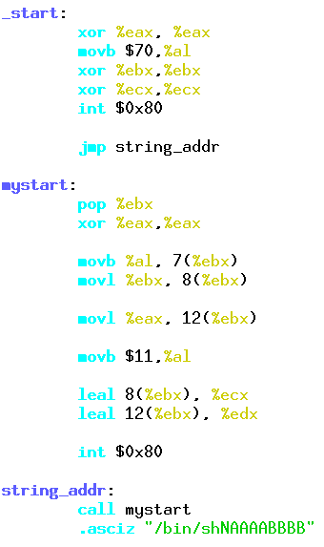
How do you create the vector?
NOP sled
shellcode
address of vector
Create the shellcode
Prepend the NOP sled:
python -c 'print "\x90"*100'
Add the address
0xbfffeeb0 (keep in mind that x86 is a
little endian architecture)
00000000 31 C0 B0 46 31 DB 31 C9 1..F1.1.
00000008 CD 80 EB 16 5B 31 C0 88 ....[1..
00000010 43 07 89 5B 08 89 43 0C C..[..C.
00000018 B0 0B 8D 4B 08 8D 53 0C ...K..S.
00000020 CD 80 E8 E5 FF FF FF 2F ......./
00000028 62 69 6E 2F 73 68 4E 41 bin/shNA
00000030 41 41 41 42 42 42 42 00 AAABBBB.

Slide 34
In reality, things are more complicated
If strcpy() is used to overflow the buffer, it will stop when it encounters the null byte. So if the shellcode contains a null byte, the attacker has a problem. So the attacker may have to encode the shellcode to remove null bytes and then generate them dynamically
There are tools (metasploit, shellnoob) that can create custom shellcode and avoid using forbidden characters

Slide 35
Countermeasures

Slide 36
How do we defend from buffer overflows?
Best defense: bound checking
Example: using strncpy() instead of strcpy()
Many modern programming languages are memory safe (e.g., Java) – no buffer overflows possible
System level countermeasures are also provided
Stack canaries
Non-executable stack
Address Space Layout Randomization (ASLR)

Slide 37
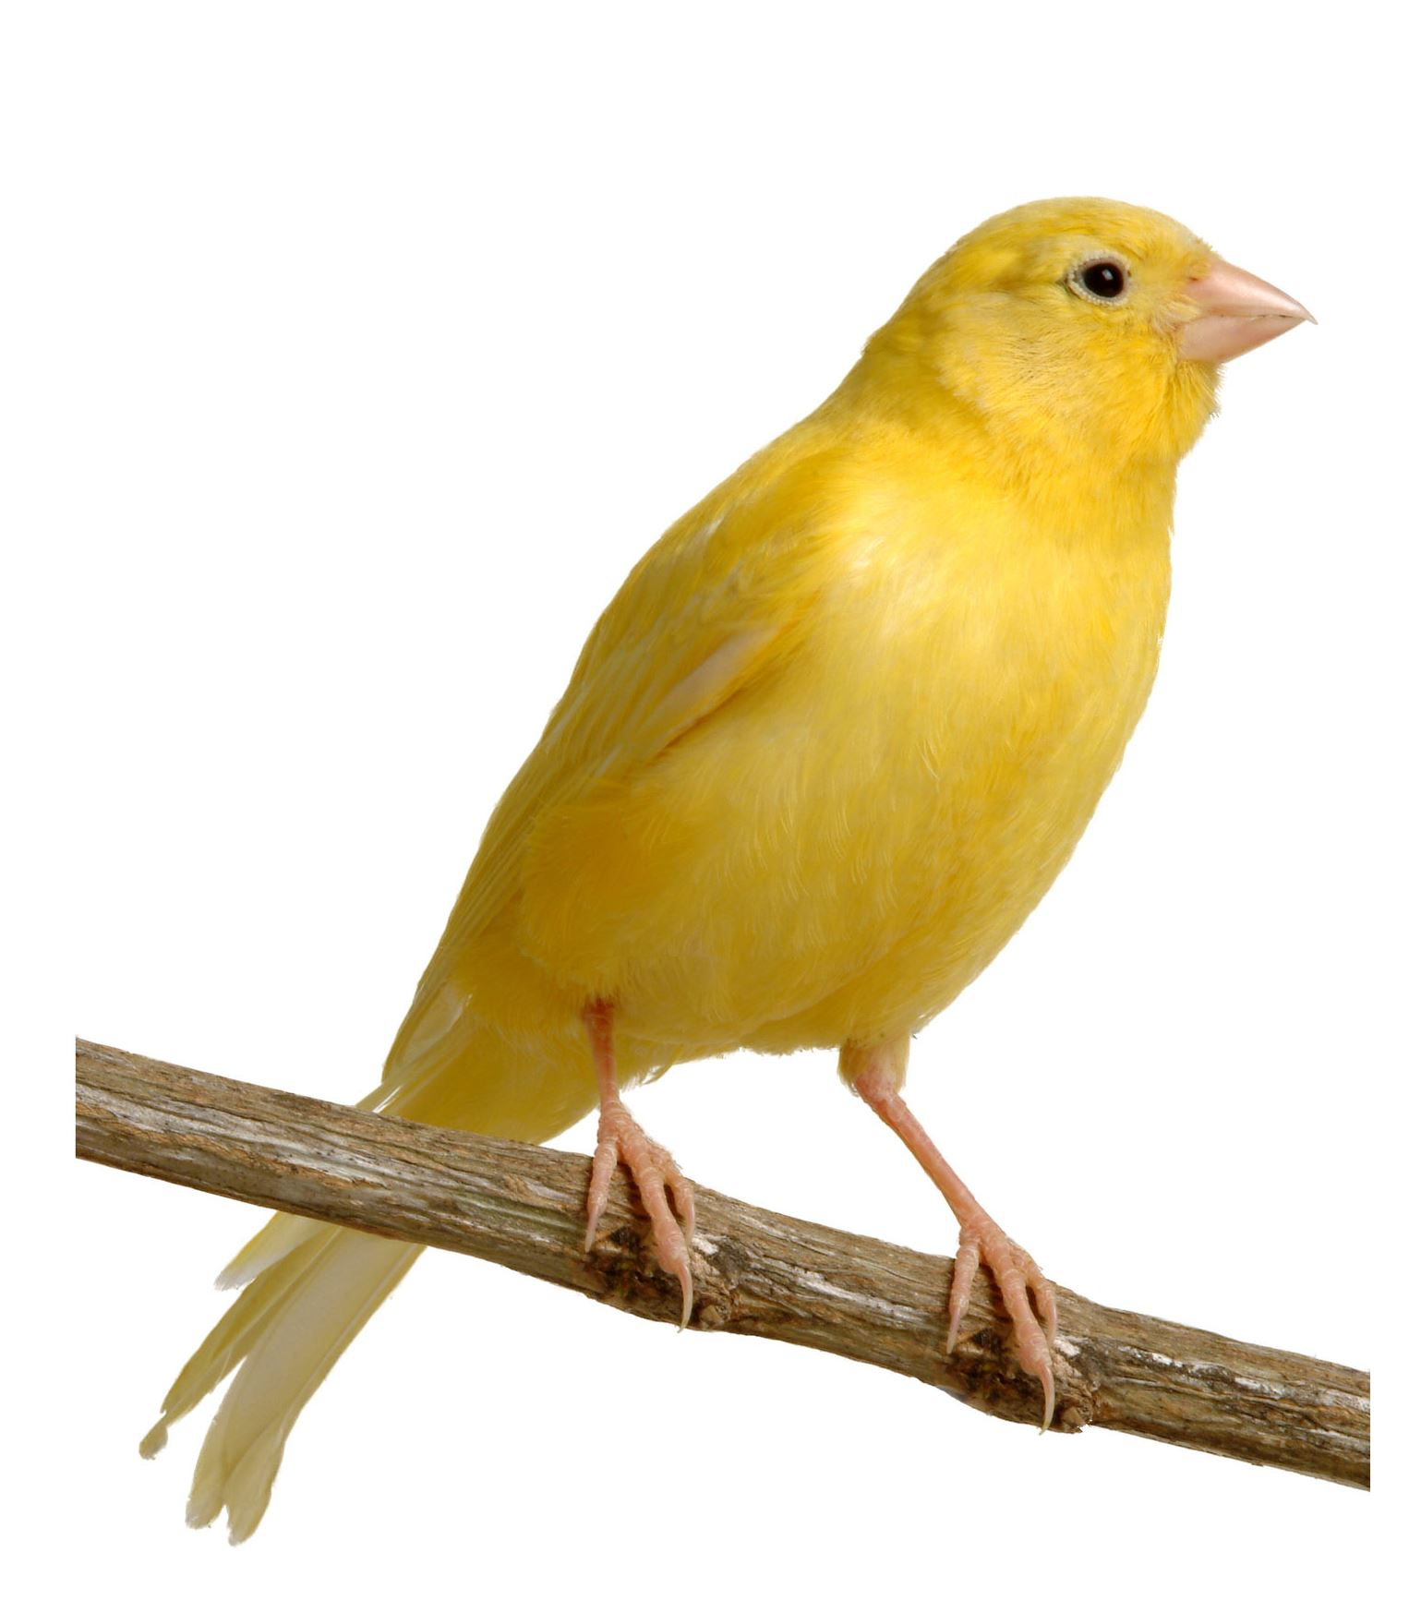
Stack Canaries
Compiler-based countermeasures: requires recompilation of programs
The function’s prologue inserts a canary on the stack
The function’s epilogue checks that the canary value is still there before returning
Does not prevent the overflow, just makes it more difficult to overwrite the return address
Return address
Frame pointer
Canary
Types of canaries:
Terminator (deterministic)
Evasion: an attacker can insert the canary back as part of the attack
Random value
Evasion: an attacker can exploit a pointer used as a destination of a strcpy()-like function and overwrite the return address without touching the canary
XOR: random value ^ return address
Evasion: an attacker can still overwrite pointers in the function’s stack frame
If the canary value doesn’t match, an exception is raised – attackers could overwrite the pointer to the exception handler (SEH) and make it point to their own function!

Slide 38
Non-executable stack
The buffer overflow example that we used earlier stores executable code on the stack and jumps to it – we could force the stack to only contain data and not code
Data Execution Prevention (DEP): separate executable memory locations from writable ones – a memory page cannot be both writable and executable at the same time.
Modern computer architectures (x86_64) provide a NX bit in hardware to specify which memory pages contain non-executable data
DEP prevents attackers from storing the shellcode on the stack, does not prevent them from overwriting the return address → return into libc attacks are possible
Notes:
Nx = non-executable

Slide 39
Return into libc
UNIX programs are linked to binary functions to make them portable – in particular, if libc is included, a number of handy functions are available to an attacker (e.g., system())
The attacker can then exploit a buffer overflow to set a fake function call frame for the system() function and have the program jump to system() after the function terminates
No executable code on the stack was used!
The attacker could chain function calls, by setting up multiple function frames in the stack and achieving more complex effects
Dummy return address
Fake stack frame for system()
Dummy stack frame pointer
Address of “/bin/sh”
Overwritten return address
Address of system()
Overflown buffer

Slide 40
Return oriented programming (ROP)
Return-to-libc attacks are fairly versatile, but sometimes the functionalities needed by an attacker cannot be found in library functions
Return oriented programming allows the attacker to build his own functions, by repeatedly jumping to small snippets of code (gadgets) located near return instructions
…
mov eax,ebx
ret
…
&gadget1
&gadget2
…
inc eax
ret
…
It is surprisingly easy to find gadgets that allow an attacker to do whatever he wants by chaining them
If you think about it, you don’t need that many gadgets to achieve Turing completeness

Slide 41
Other locations that attackers can overwrite
Global Offset Table (GOT) – used by the linker to keep the addresses of the functions called in a program. The GOT is writable, therefore an attacker can overwrite the address to a function (for example printf) and have a function of his choice executed instead next time printf is called
The .dtors Section – contains code to be executed after the actual program code (stands for destructors). This section is writable too, and the attacker can use it to point to code that will be run when the program is terminating
Off by one overflows – programs start counting from 0, humans from 1 – this can cause code to allow writing one byte too much in memory!
Attackers can use this to overwrite the least significant byte in the previous contiguous memory address → overwrite the least significant byte of an address

Slide 42
Address space layout randomization (ASLR)
Idea: re-arrange the position of key data areas randomly (stack, code, shared libraries)
Effect on exploits:
Buffer overflow: the attacker does not know the address of the shellcode
Return-into-libc: the attacker cannot predict the address of the library function
ROP: the attacker cannot predict the address of the code gadgets
Natively implemented on Linux > 2.6.11, Windows Vista or later, …
Problems:
32-bit implementations use few randomization bits (bruteforce possible)
If an attacker can read an address at runtime (through memory leakage) she can adjust her exploits accordingly

Slide 43
ASLR can be defeated
In a paper titled “ASLR on the Line: Practical Cache Attacks on the MMU” researchers from VU Amsterdam show that the Cache mechanism of modern systems can be used as a side channel to retrieve the memory offset at which programs are loaded.
They provide a JavaScript proof of concept, meaning that ASLR can be defeated in your browser!

Slide 44
Additional Countermeasures: Control Flow Integrity
Can we make sure that a program follows the expected flow?
The Control Flow Integrity security policy dictates that software execution must follow a path that is determined ahead of time
Typical implementation:
Static analysis to determine the expected control flow graph (CFG)
Code rewriting to enforce the program flow + runtime checks
main()
function()
Error!
Shellcode

Slide 45
Control flow integrity: issues
CFI presents multiple challenges
The control flow of a program is not deterministic – needs to take into account dynamic checks
Static analysis is not perfect, especially in the case of pointer analysis and if no source code is present – needs to allow a somewhat “flexible” control flow
Enforcing CFI has performance implications (5-10% usually)
Researchers keep breaking CFI schemes and coming up with improved ones

Slide 46
Some reading
“Smashing the Stack for Fun and Profit” by Aleph One
“The Geometry of Innocent Flesh on the Bone: Return-into-libc without functions calls (on the x86)” by H. Shacham

